Slide 1
Basic analysis of NYC car accidents data from January until august 2020

Slide 3
In 2020, NYC recorded a total of 74,881 crashes. Among these, 20,421 (27.27%) involved injuries, and 135 (0.18%) were fatal. In total, 27,448 people were injured and 144 were killed. Most crashes occurred in Brooklyn (30.35%) and Queens (27.36%), followed by the Bronx (17.82%),Manhattan (14.94%) and Staten Island (3.45%), with approximately 6% having an unreported location. The number of crashes peaked in January and February, with the highest frequency at 4 PM. Notably, the "rush hour" for crashes involving injuries or fatalities was at 6 PM (see next slide).

Slide 4
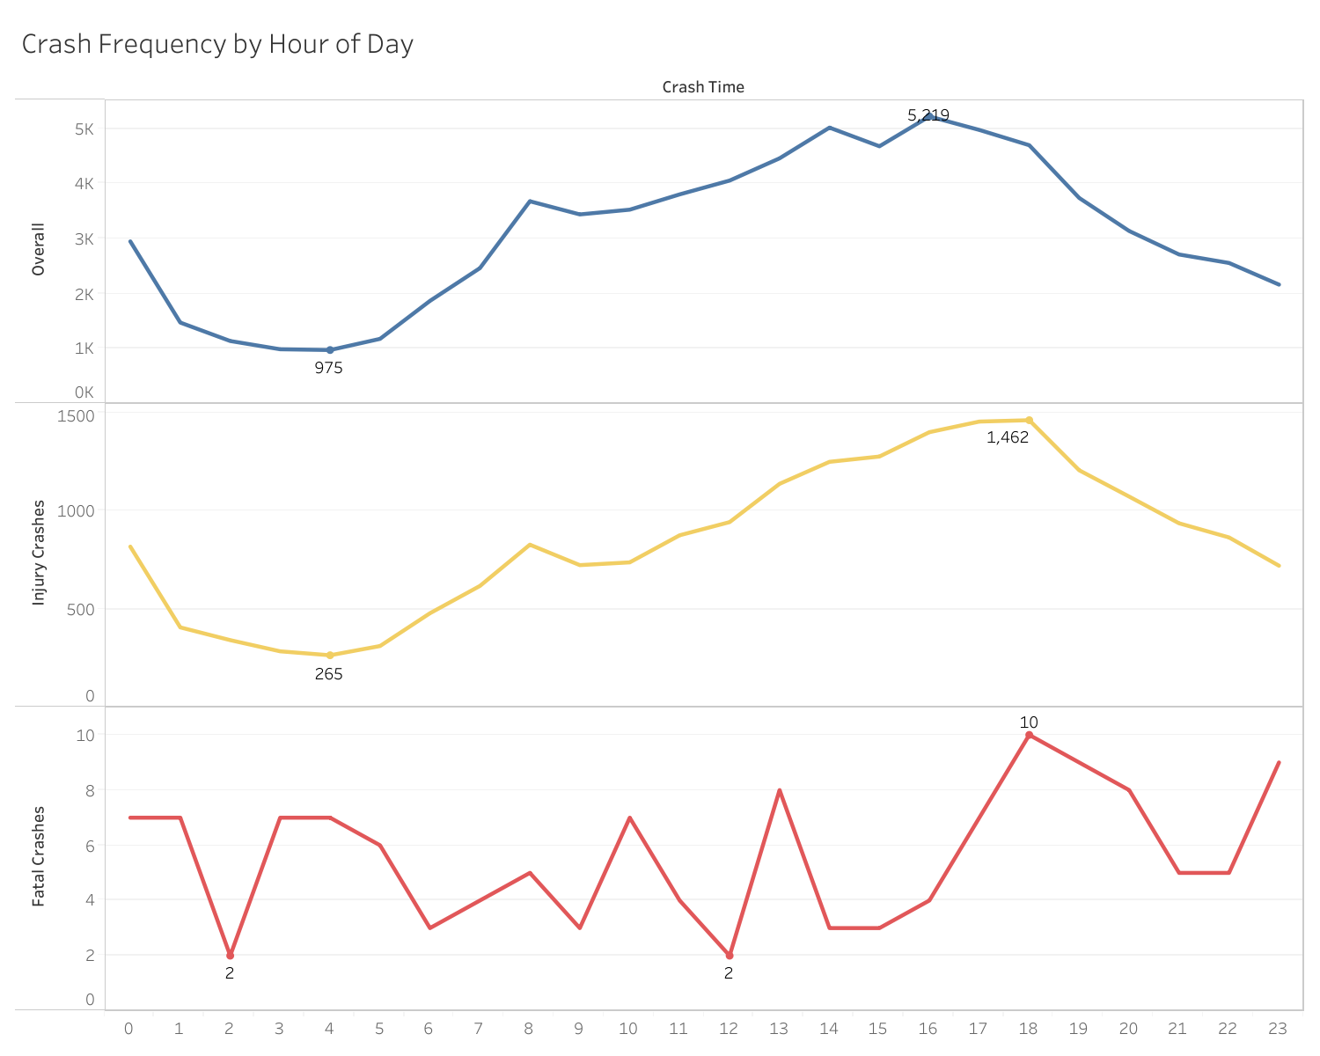
Crash Frequency by Time of Day

Slide 5
Crash Frequency by Time of Day
The correlation between the crash severity (non injury, injury, fatal) and the time of day was investigated. The Pearson correlation coefficient was found to be 0.054 (and P-value: 7.116e-49), suggesting very weak positive correlation between the two.

Slide 6
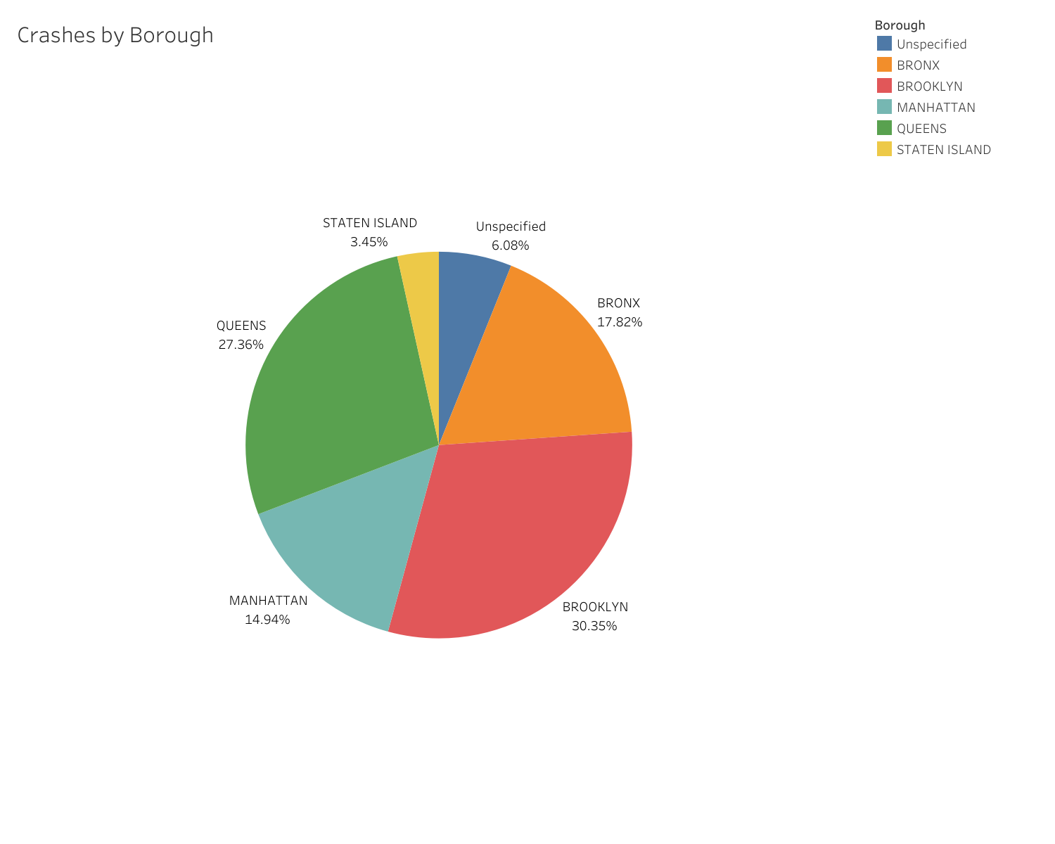

Slide 7
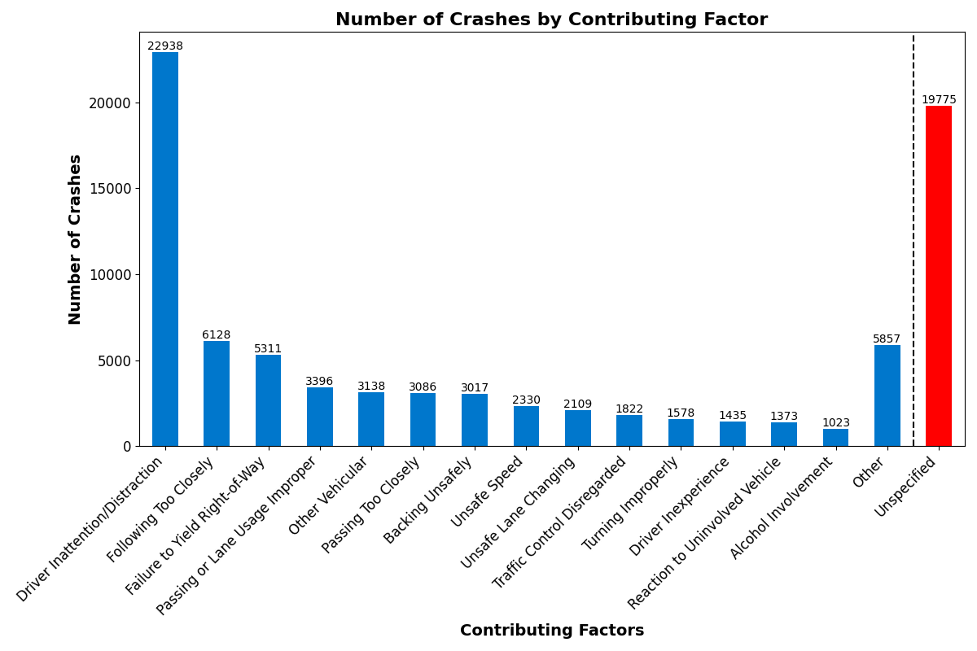
Contributing Factors
The most common contributing factors are presented below.

Slide 8
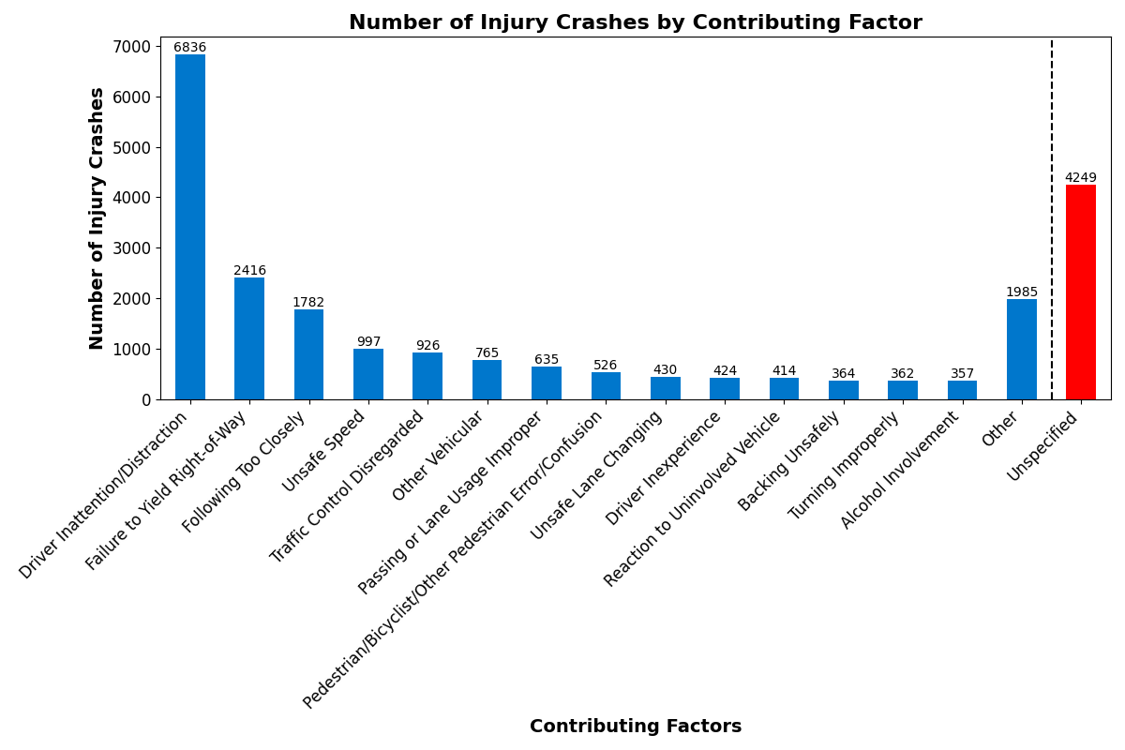
Contributing Factors
The most common contributing factors for injury crashes are

Slide 9
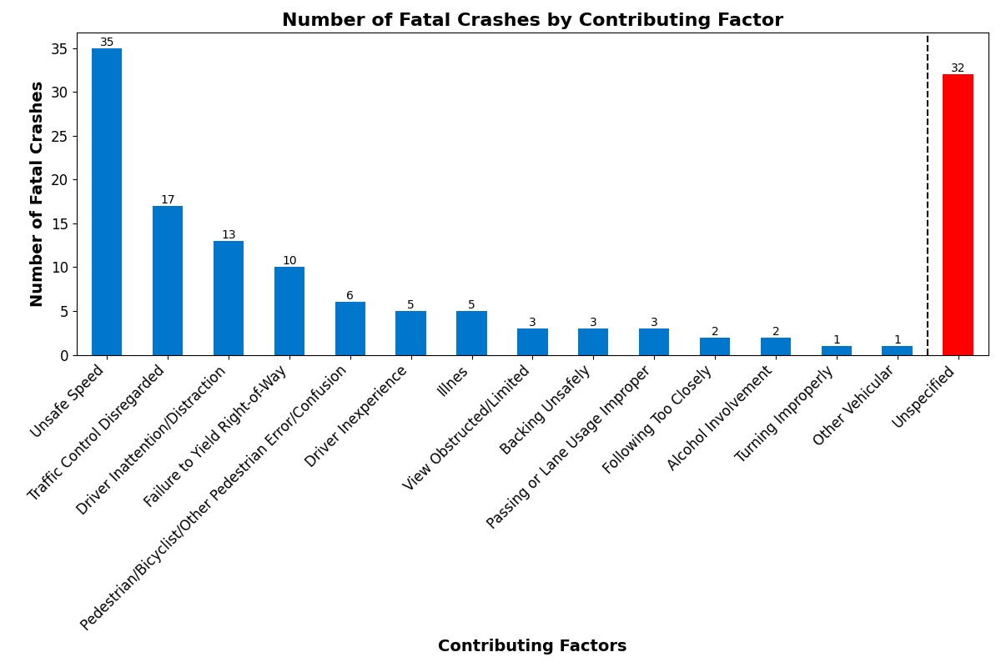
Contributing Factors
And the most common contributing factors for fatal crashes are

Slide 10
Contributing Factors
Unsafe speed is a factor in just over a quarter (25.9%) of fatal crashes. Traffic control disregard contributes approximately 12.5%, while driver inattention/distraction accounts for nearly 10%.
For injury crashes, driver inattention/distraction is the leading factor, contributing just over a third (33.47%). The second most common contributing factor is failure to yield right of way, at 11.83%.

Slide 11
Contributing Factors
In the next slide, a map shows the locations of crashes in Brooklyn and Queens with contributing factors from the top 10 previously listed.

Slide 12
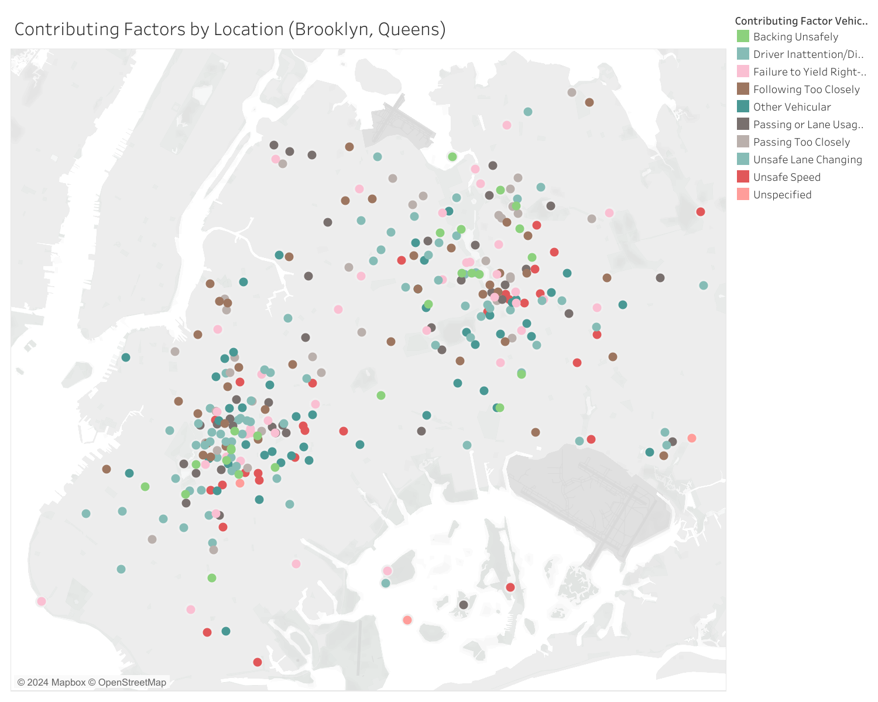
Contributing Factors

Slide 13
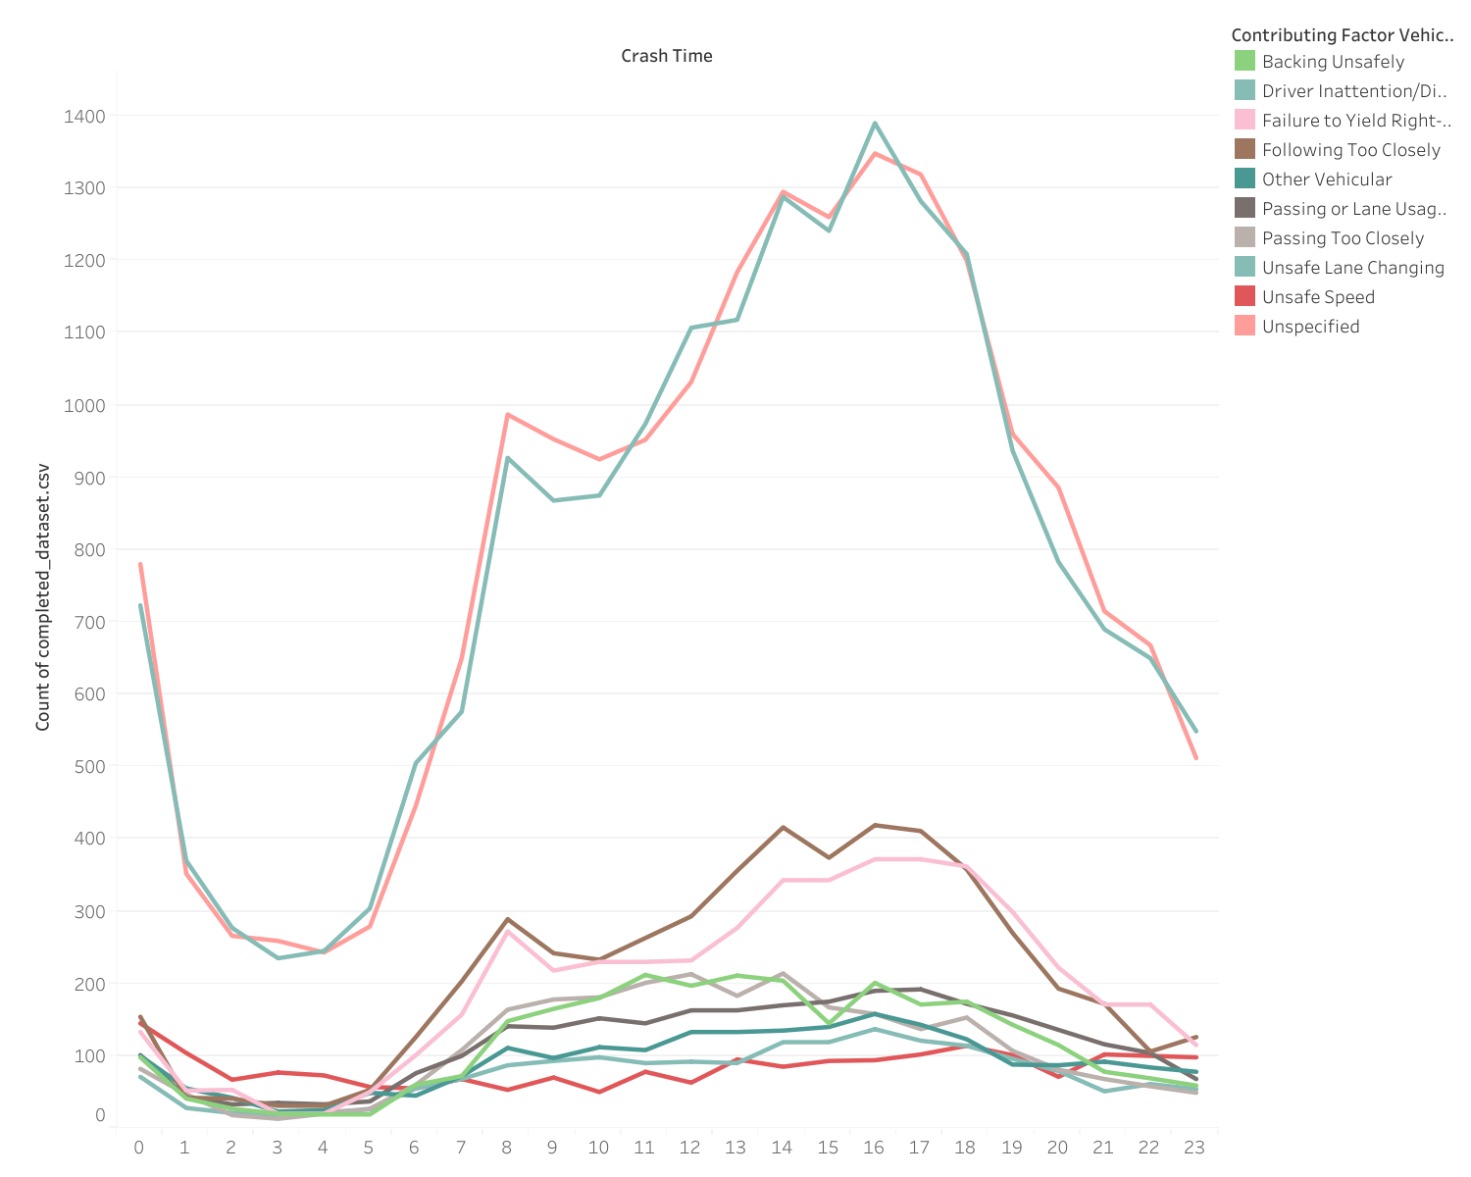
Contributing Factors

Slide 14
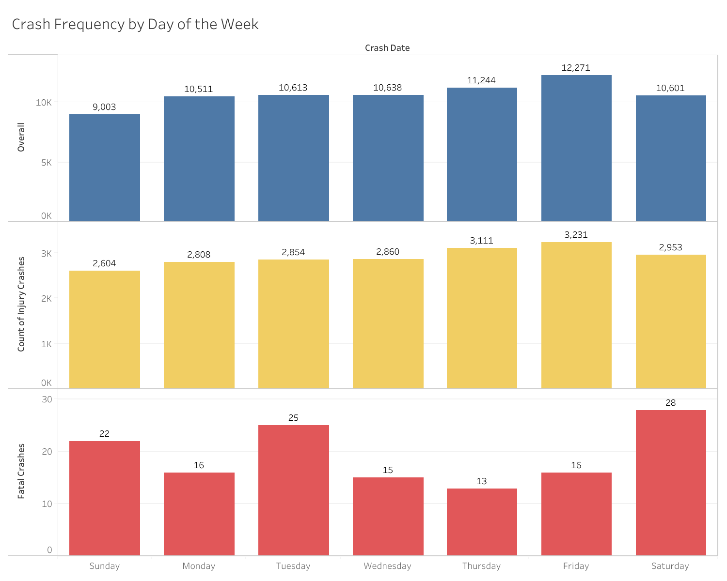
Crash Frequency by Day of the Week

Slide 15
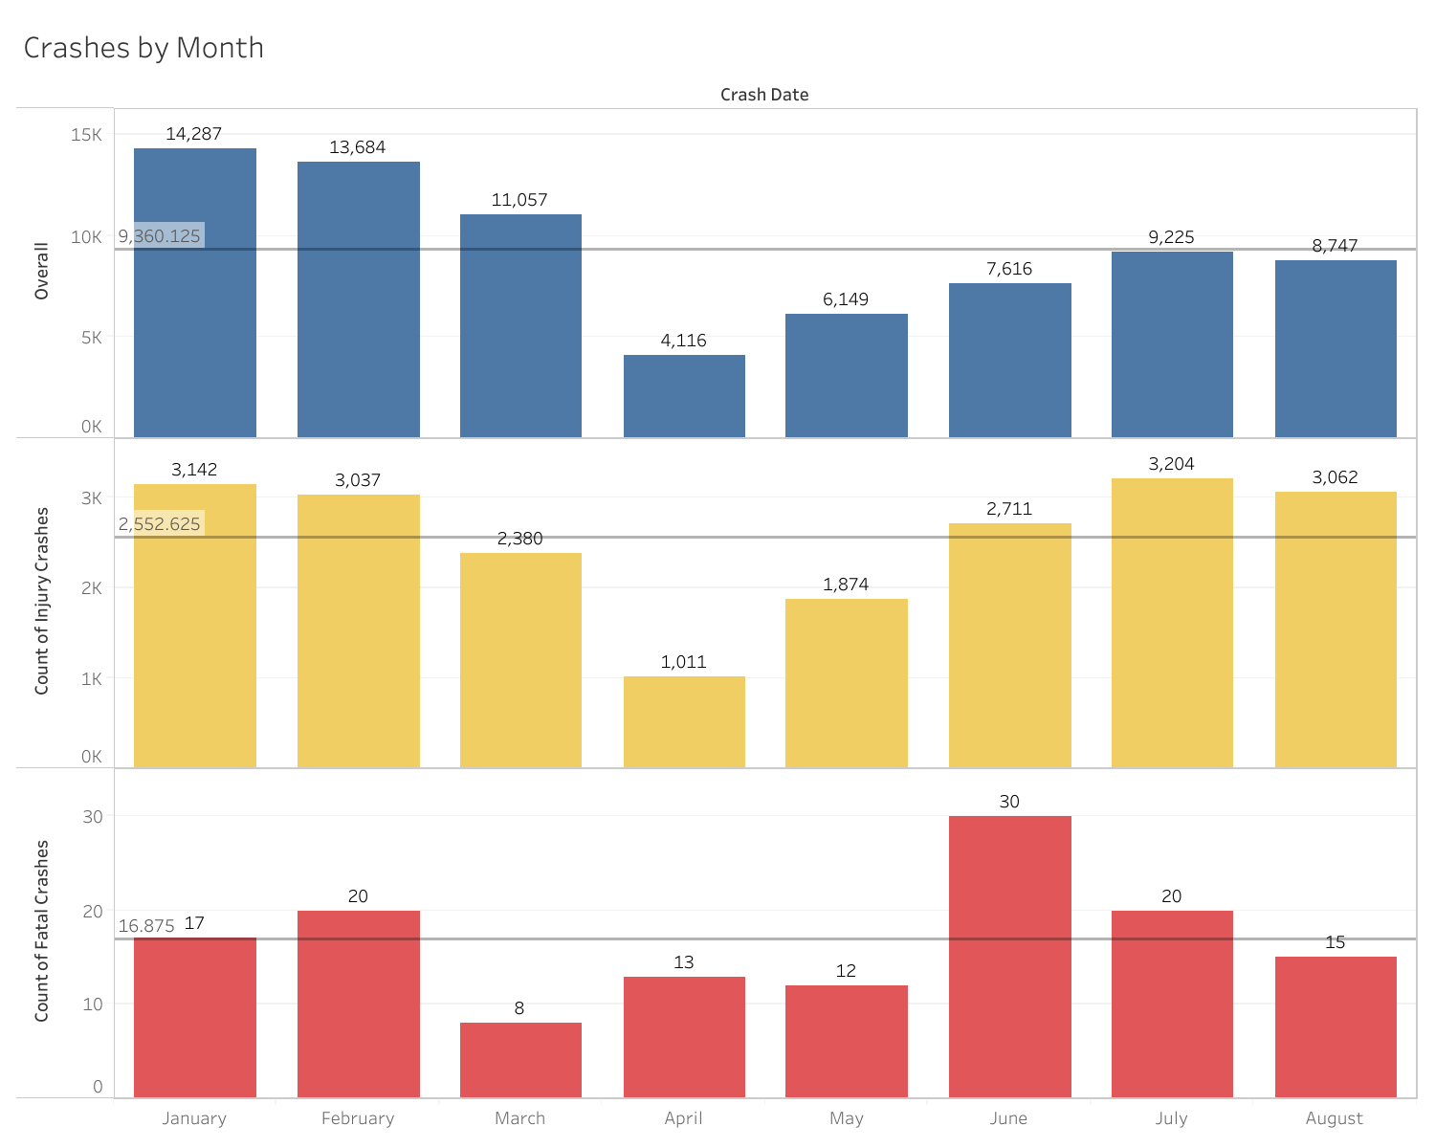
Crashes by Month

Slide 16
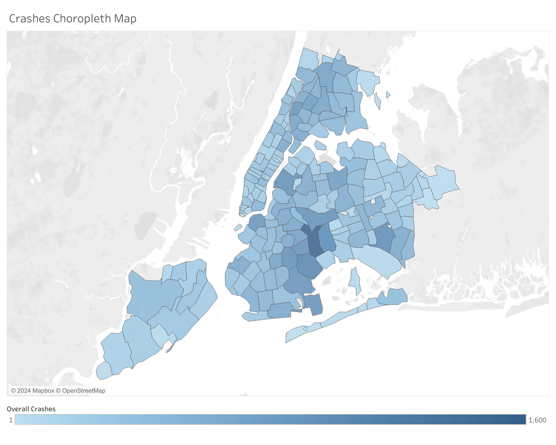
Crashes by Location in NYC

Slide 17
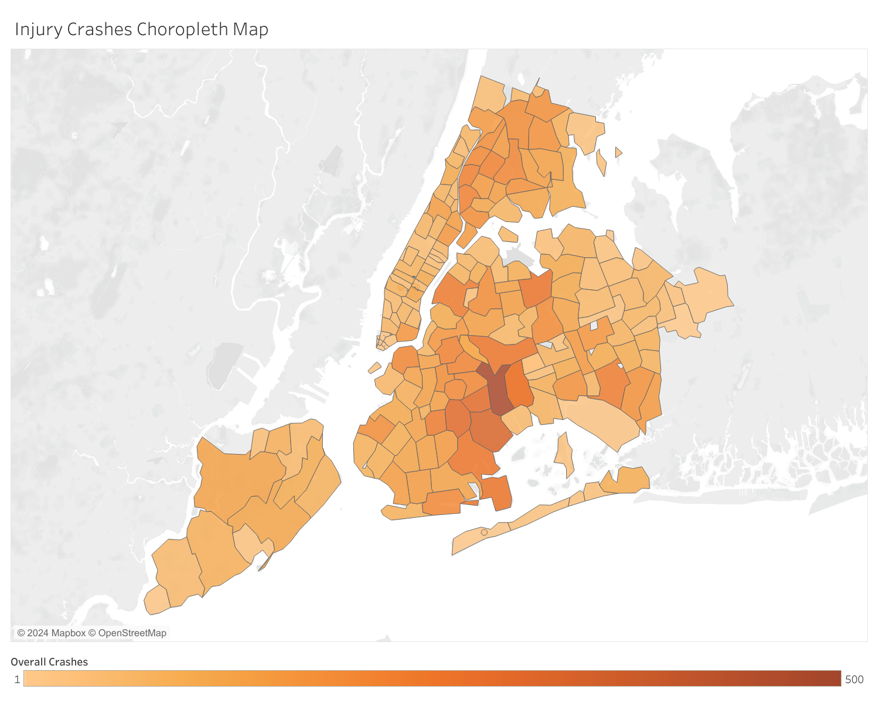
Crashes by Location in NYC

Slide 18
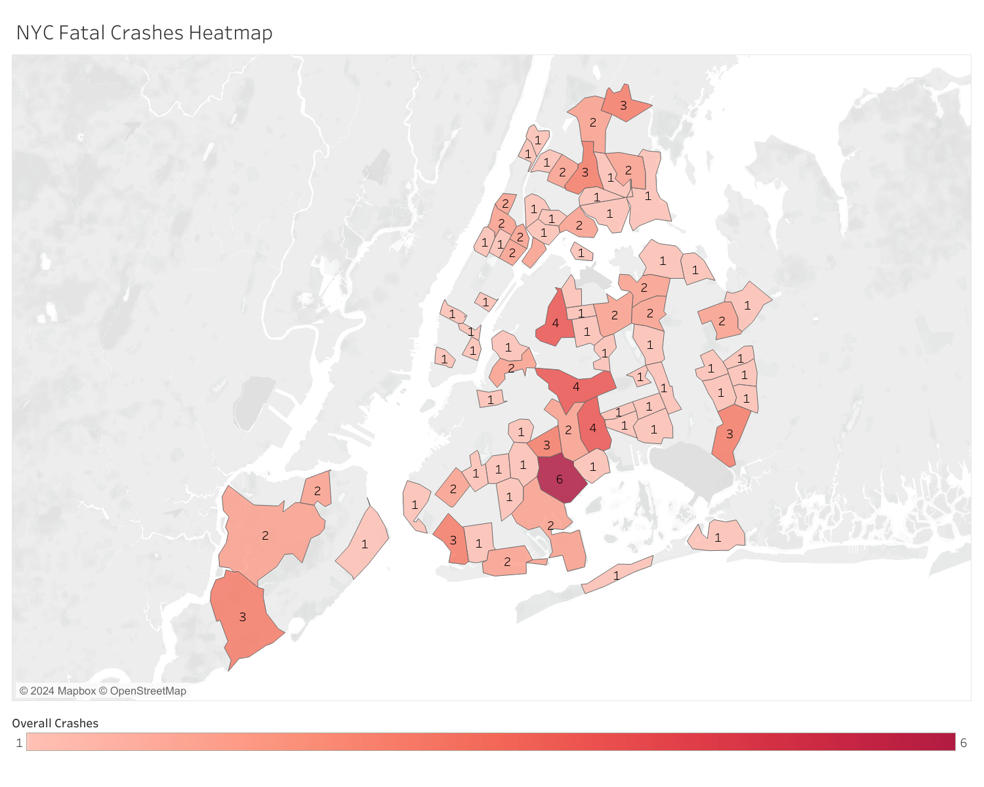
Crashes by Location in NYC

Slide 19
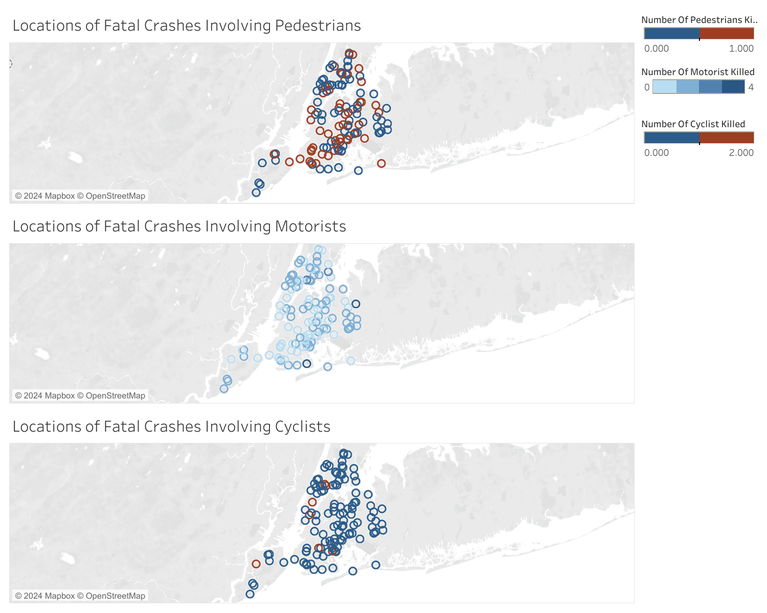
Crashes by Location in NYC

Slide 20
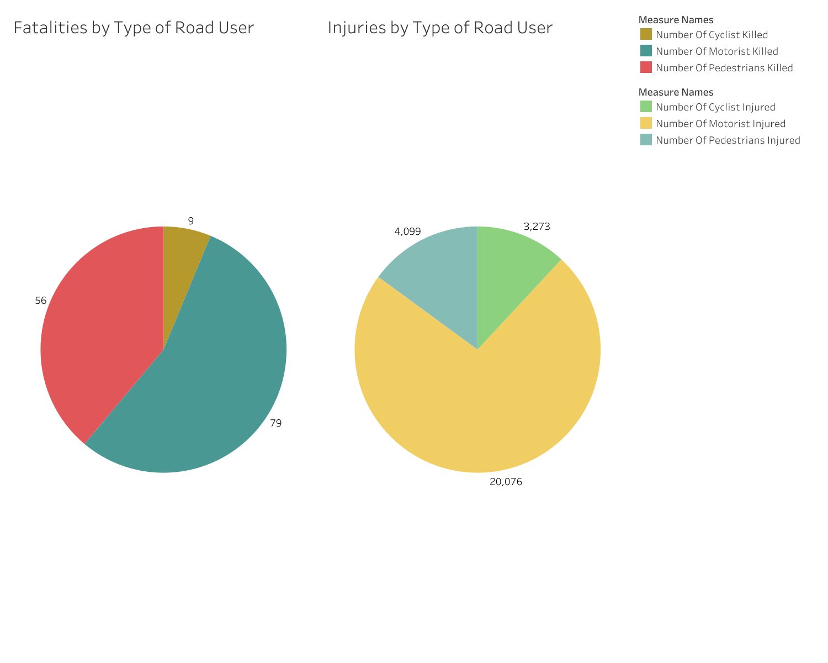
Road Users Injuries and Fatalities

Slide 21
Road Users Injuries and Fatalities
27,448 people were injured and 144 were killed in the discussed period. The following table shows percentages based on the pie charts:
Road user type | % of injuries | % of fatalities
Motorist | 73.14% | 54.86%
Pedestrian | 14.93% | 38.88%
Cyclist | 11.92% | 6.25%

Slide 22
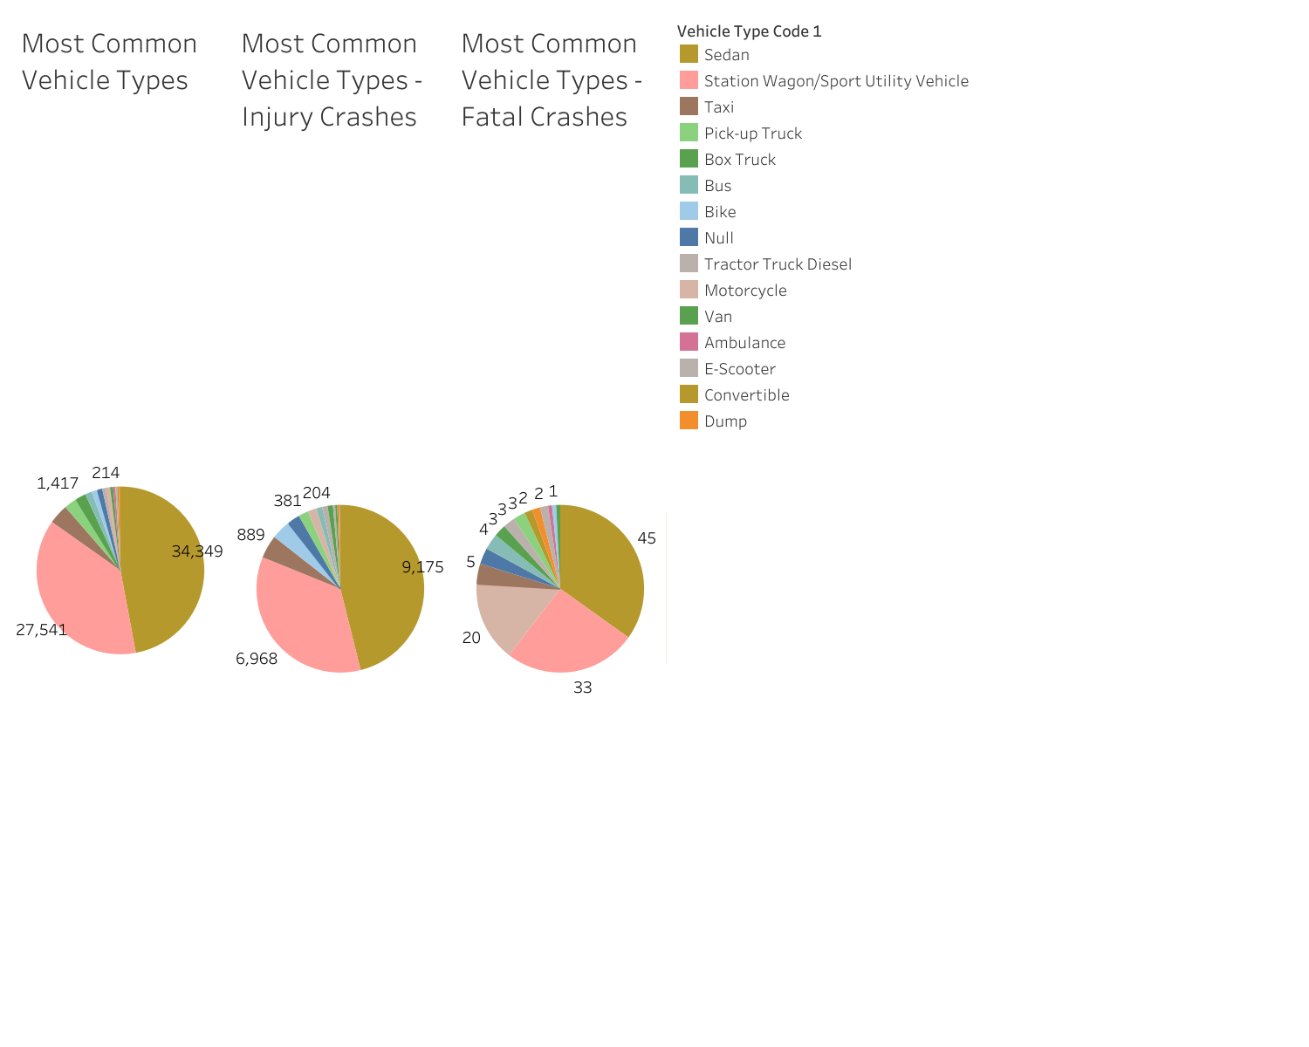
Crashes by Vehicle Type

Slide 23
Some ideas for further analysis
Analyze car accidents frequency and severity during holidays / bank holidays
Check for correlation between vehicle type and crash severity
Analyze specific streets and locations
Etc.

